Slide 1


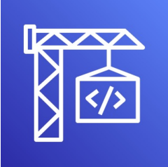
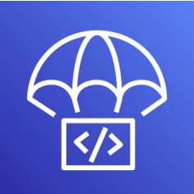

Deployment of Application with CI/CD pipeline

Slide 2
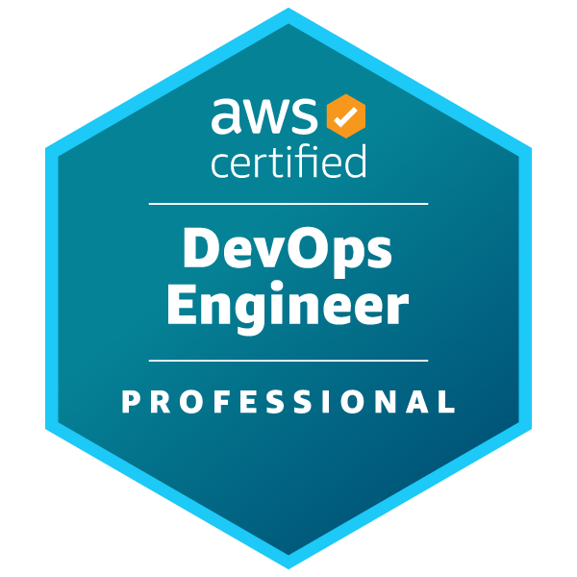
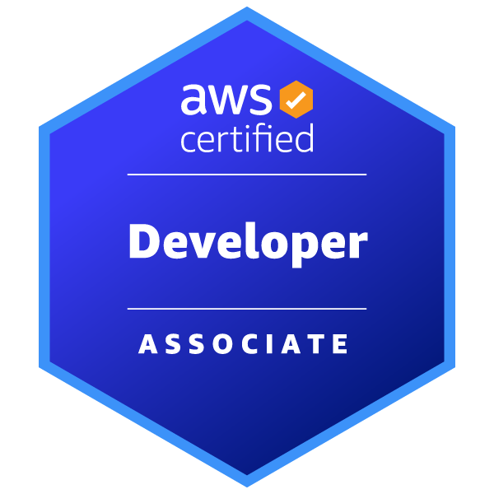

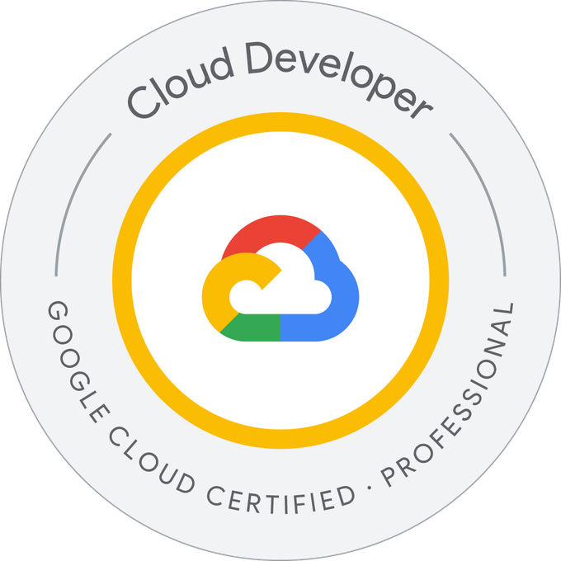






Introduction
Parag Sanyashiv
Senior Platform Architect - PCL
6+ Years of Experience in Implementation and Architecting Solution in NewRocket India Pvt. Ltd.
Pune, India
Expertise:
ITOM
ITAM
ITSM
Platform Integration
Hybrid Cloud Development

Slide 3
Agenda
CICD
Code Repository
AWS CodePipeline
AWS CodeBuild
AWS CodeDeploy
AWS CodeGuru

Slide 4
Outcome
Understanding and using the GitHub Repository
Understanding the AWS CodePipeline and Handson
Understanding the AWS CodeBuild and Hands-on
Understanding the AWS Code Deploy Basics
10000 ft overview of AWS Code Guru

Slide 5
Aws terminology
EC2 – Elastic Cloud Compute
ASG – Auto Scaling Group
ELB – Elastic Load Balancer
SG – Security Group
S3 – Simple Storage Service
EBS - Elastic BeanStalk
ECS – Elastic Container Service

Slide 6
CI/CD

Slide 7

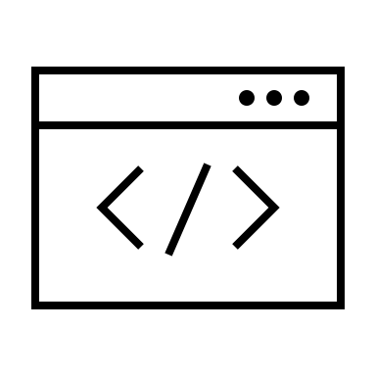
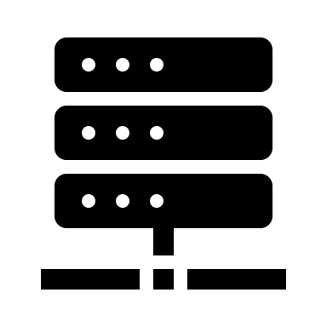

Continuous Integration (CI)
First, Developers push the code to a code repository after development. For eg: GitLab, GitHub, Bitbucket, etc.
After pushing, code needs to be build and tested.
The building and testing can be automated using build servers. i.e. CodeBuild, Jenkins, etc.
The build/test output and feedback are sent to developers to check the test cases, which allows finding bugs and fix them.
This provides faster delivery and often deployments of application.
Developer
Build & Test Output
Push Code
Fetch code
Build Server
Repository

Slide 8
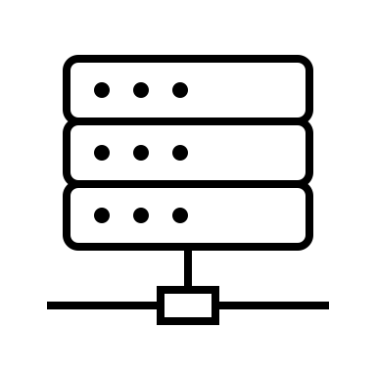
Continuous Delivery (CD)
Ensures that the software can be released reliably whenever needed
Ensures deployments happen often and are quick
Shift away from “one release every 3* months” to “multiple releases a day”
This means automated deployment (e.g. CodeDeploy, Jenkins CD, Spinnaker, etc.)
Developer
Code Repository
Build Server
Deployment Server
Application Server v1
Application Server v2

Slide 9
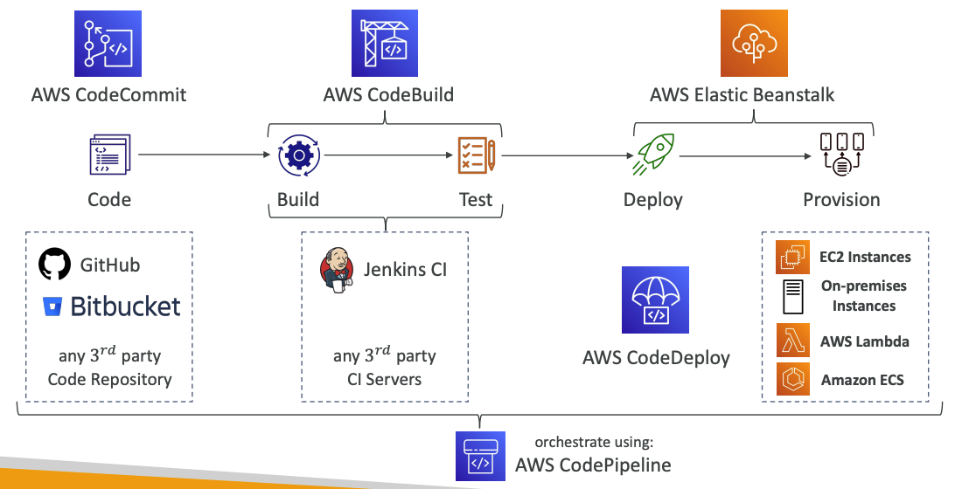
Technology Stack for CICD

Slide 10
Code Repository

Slide 11

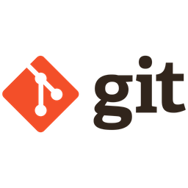
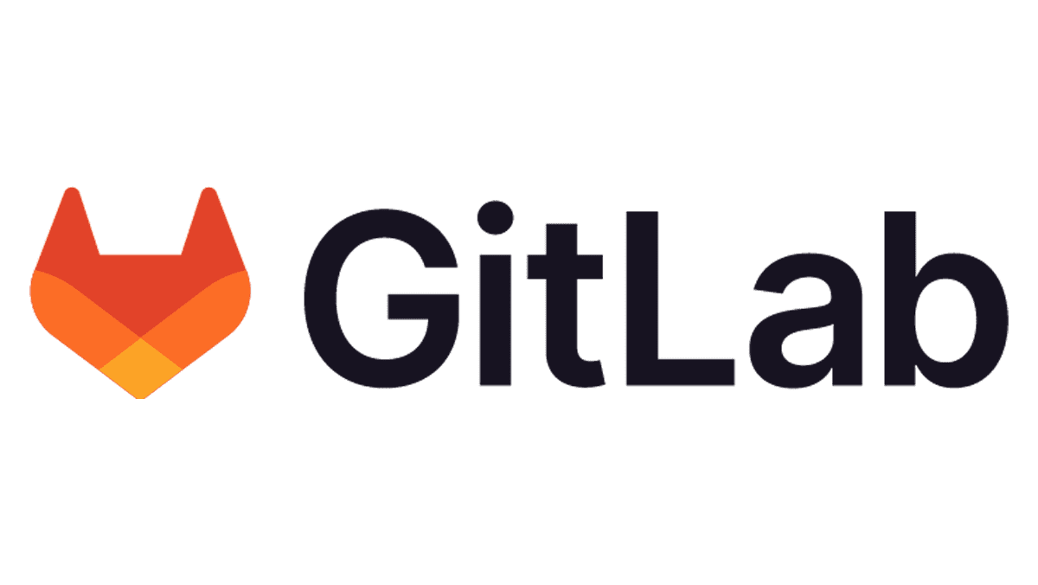
CodeCommit – Deprecation
On July 25th 2024, AWS abruptly discontinued CodeCommit
AWS now recommends to migrate or use an external Git Solution

Slide 12
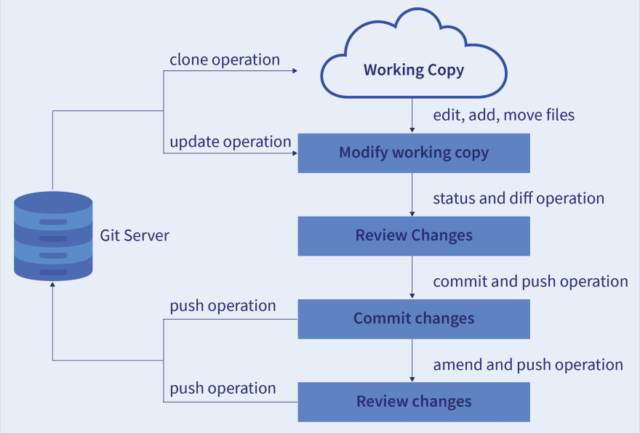
What is GIT?
Free and OpenSource distributed version control system to track the changes.
It favors both, technical and non-technical
Version control – To record all the changes made to a file or set of data. This help developers to track and review the changes to the code.
It also allows multiple developer to work together (Use of Branch)

Slide 13
AWS Code Pipeline

Slide 14
AWS Code Pipeline
Visual Workflow to orchestrate your CICD
Source – S3, BitBucket, GitHub, Git, BitBucket, etc.
Build – CodeBuild,Jenkins, CloudBees, TeamCity, etc.
Test – CodeBuild, AWS Device Farm, 3rd Party tools, etc.
Deploy – CodeDeploy, Elastic Beanstalk, CloudFormation, ECS, S3, etc.
Invoke – Lambda, Step Function
It consists of Stages:
Each stage can have sequential actions and/or parallel actions
Eg. Build -> Test -> Deploy -> Load Testing -> so on…
Manual approval can be defined at any stage

Slide 15
Technology Stack for CICD

Slide 16
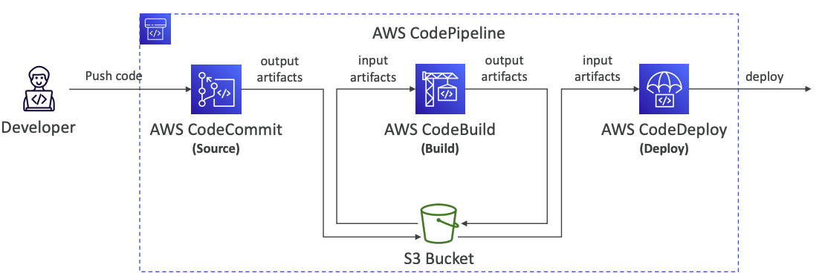
Code Pipeline - Artifacts
Each pipeline stage can create artifacts
Artifacts stored in an S3 bucket and passed on to the next stage

Slide 17
Code Pipeline - Troubleshooting
For CodePipeline Pipeline/Action/Stage Execution State Changes
Use CloudWatch Events.
If CodePipeline fails a stage, your pipeline stops and you can get information in the console
If pipeline can’t perform an action, make sure the “IAM Service Role” attached does have enough IAM permission (IAM Policy)
AWS CloudTrail can be used to audit AWS API calls.

Slide 18
AWS CodeBuild

Slide 19
AWS CodeBuild
A fully managed continuous integration (CI) service
Continuous scaling (no servers to manage or provision – no build queue)
Compile source code, run tests, produce software packages...
Alternative to other build tools (e.g., Jenkins)
Charged per minute for compute resources (time it takes to complete the builds)
Leverages Docker under the hood for reproducible builds
Use prepackaged Docker images or create your own custom Docker image
Security:
Integration with KMS for encryption of build artifacts
IAM for CodeBuild permissions, and VPC for network security
AWS CloudTrail for API calls logging

Slide 20
AWS CodeBuild (Cont.)
Source – CodeCommit, S3, Bitbucket, GitHub
Build instructions: Code file buildspec.yml or insert manually in Console
Output logs can be stored in Amazon S3 & CloudWatch Logs
Use CloudWatch Metrics to monitor build statistics
Use EventBridge to detect failed builds and trigger notifications
Use CloudWatch Alarms to notify if you need “thresholds” for failures
Build Projects can be defined within CodePipeline or CodeBuild
CodeBuild Supported Environments:
Java, Ruby, Python, Go, Nodejs, Android, .NETCore, PHP, Dockers

Slide 21
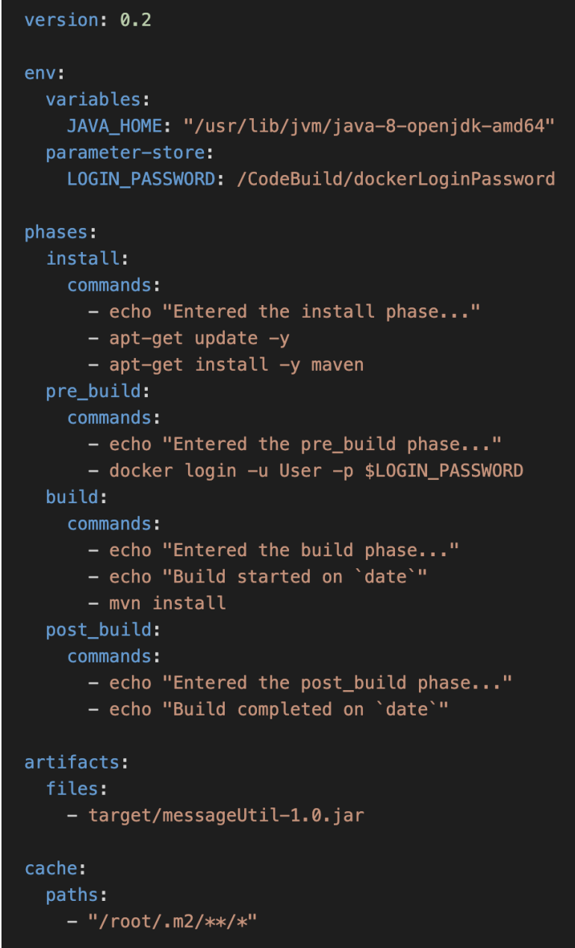
CodeBuild – buildspec.yml
buildspec.yml file must be at the root of your code
env – define environment variables
variables – plaintext variables
parameter-store – variables stored in SSM Parameter Store
secrets-manager – variables stored in AWS Secrets Manager
phases – specify commands to run:
install – install dependencies you may need for your build
pre_build – final commands to execute before build
Build – actual build commands
post_build – finishing touches (e.g., zip output)
artifacts – what to upload to S3 (encrypted with KMS) (For Security)
cache – files to cache (usually dependencies) to S3 for future build speedup

Slide 22
AWS CodeDeploy

Slide 23
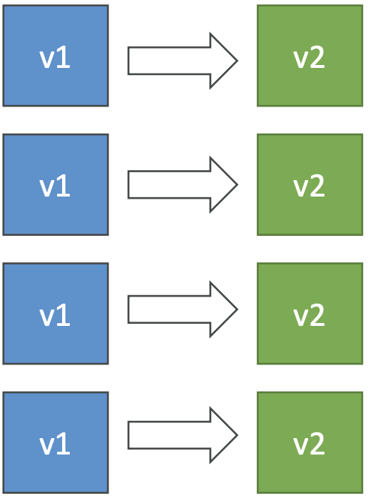
AWS CodeDeploy
Deployment service that automates application deployment
Deploy new applications versions to EC2 Instances, On -premises servers, Lambda functions, ECS Services
Automated Rollback capability in case of failed deployments, or trigger CloudWatch Alarm
Gradual deployment control
A file named appspec.yml defines how the deployment happens

Slide 24

CodeDeploy – EC2/On-premises Platform
Can deploy to EC2 Instances & on-premises servers
Perform in-place deployments or blue/green deployments
Must run the CodeDeploy Agent on the target instances
Define deployment speed
AllAtOnce: most downtime
HalfAtATime: reduced capacity by 50%
OneAtATime: slowest, lowest availability impact
Custom: define your %

Slide 25
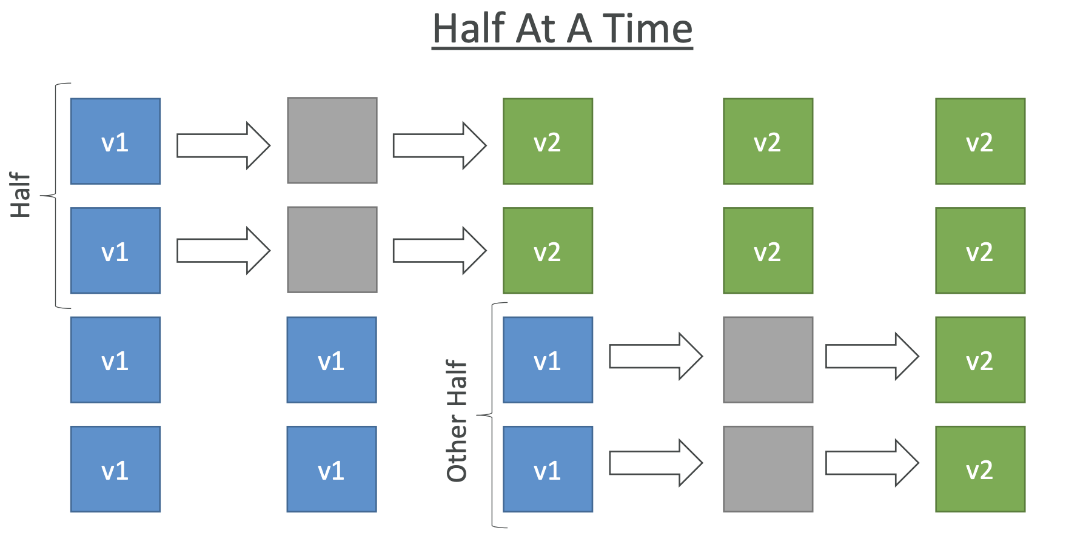
CodeDeploy – In-Place Deployment

Slide 26
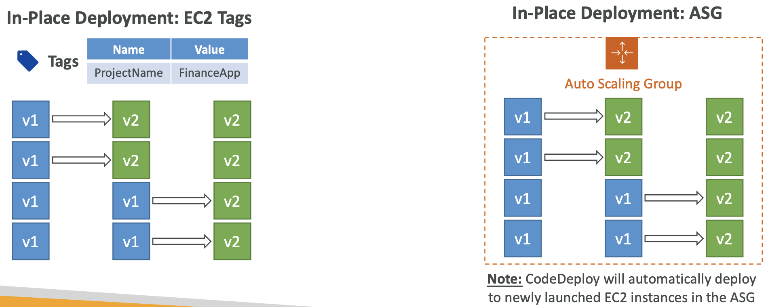
CodeDeploy – In-Place Deployments
Use EC2 Tags or ASG to identify instances you want to deploy to
With a Load Balancer: traffic is stopped before instance is updated, and started again after the instance is updated
Notes:
ASG = Auto Scaling Group

Slide 27
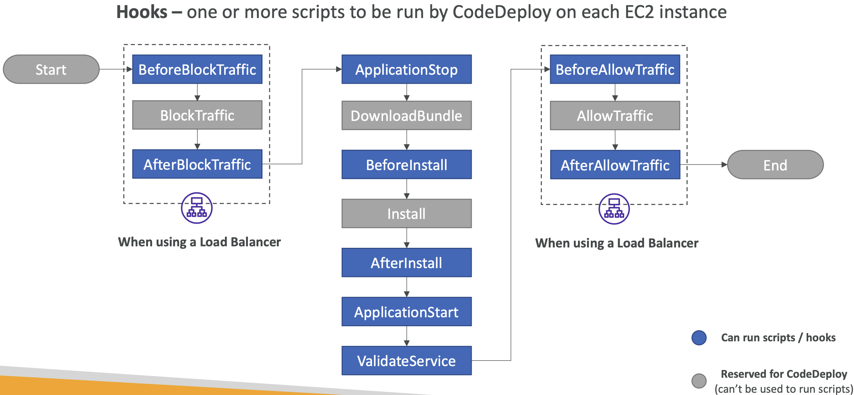
CodeDeploy – In-Place Deployment Hooks (KB)

Slide 28
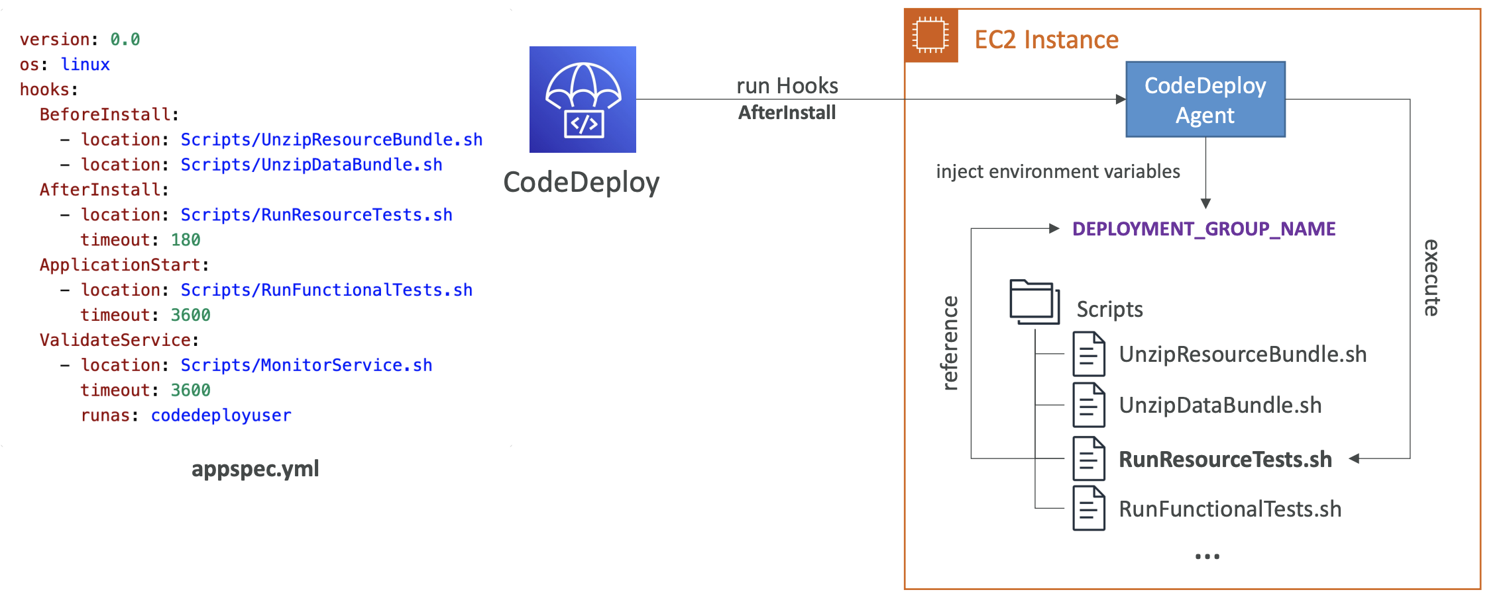
CodeDeploy – EC2 Deployment Hooks (KB)

Slide 29
CodeDeploy – Deployment Hooks Example
BeforeInstall – used for preinstall tasks, such as decrypting files and creating a backup of the current version
AfterInstall – used for tasks such as configuring your application or changing file permissions
ApplicationStart – used to start services that stopped during ApplicationStop
ValidateService – used to verify the deployment was completed successfully
BeforeAllowTraffic – run tasks on EC2 instances before registered to the load balancer
Example: perform health checks on the application and fail the deployment if the health checks are not successful

Slide 30
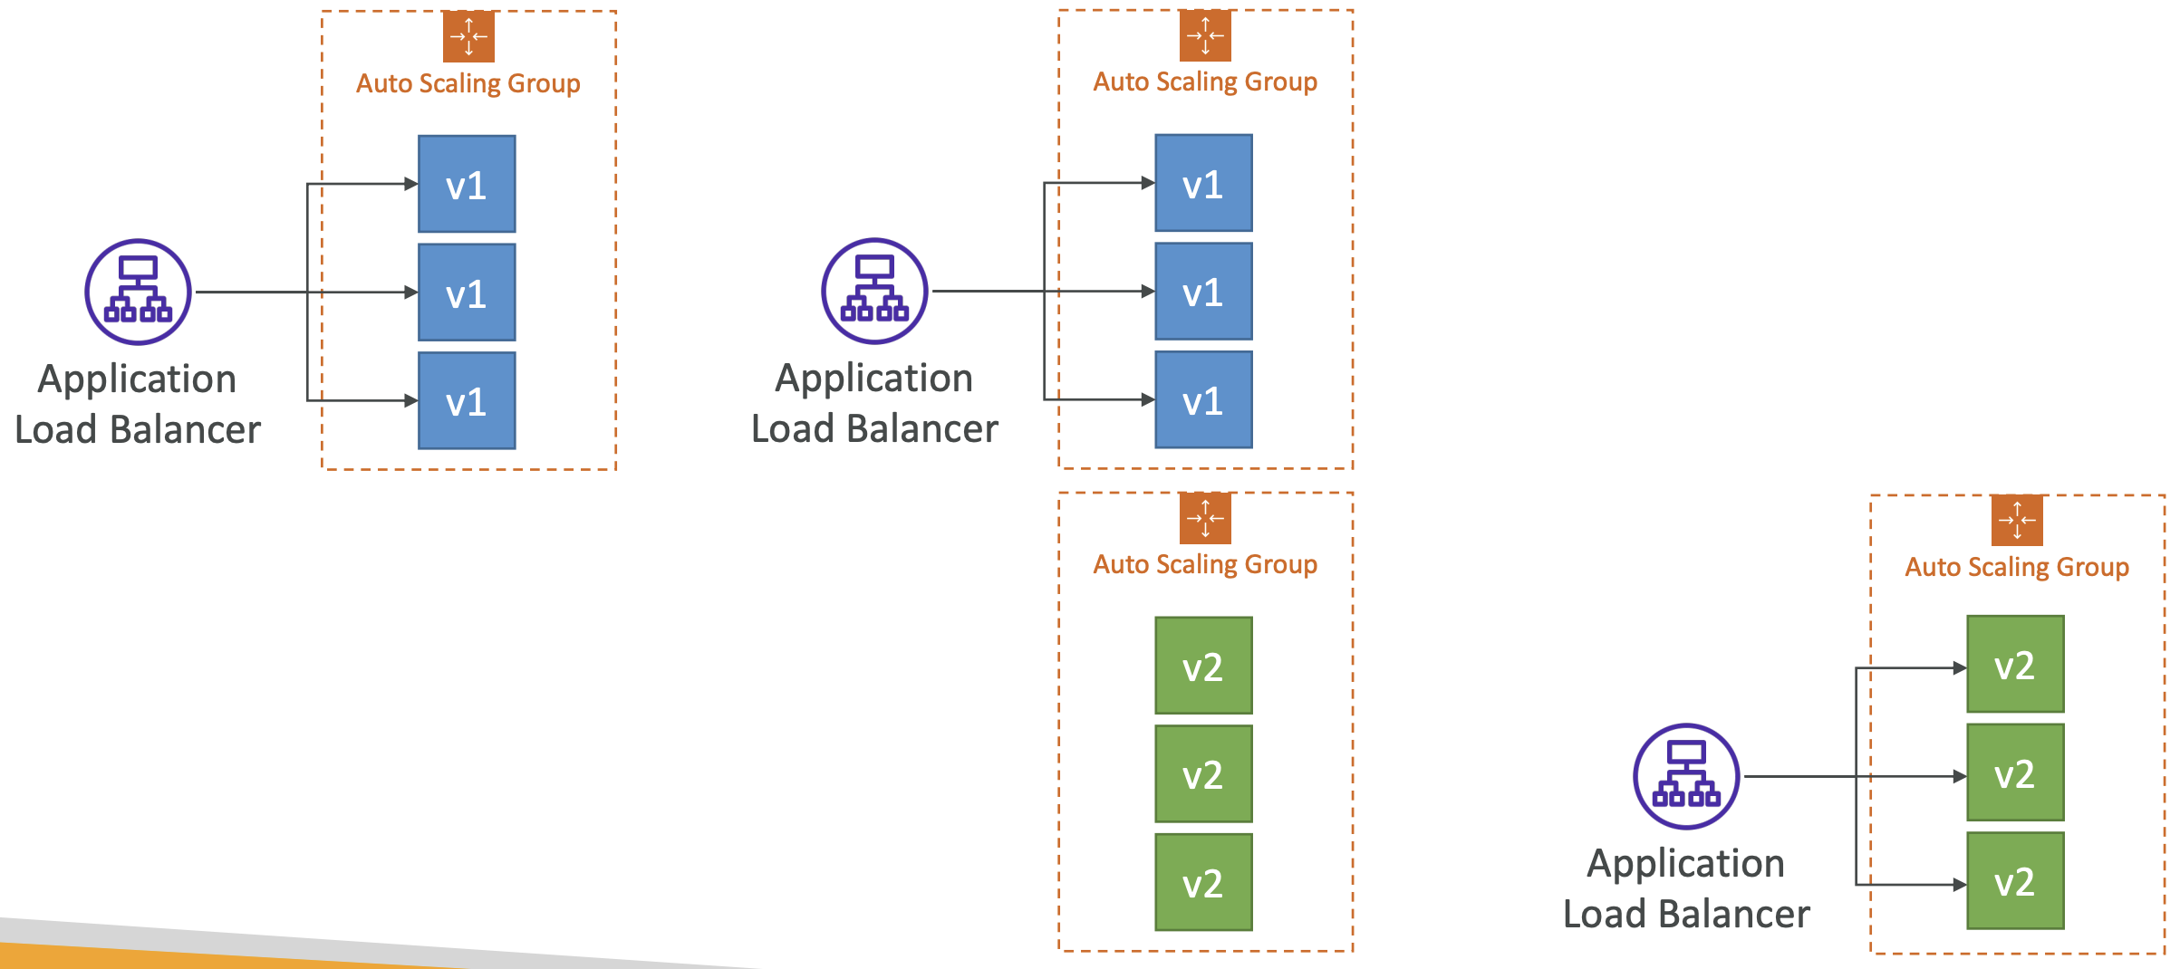
CodeDeploy – Blue-Green Deployment

Slide 31
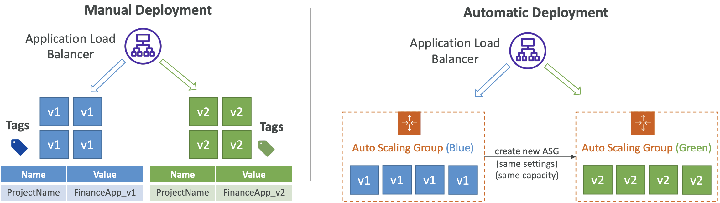
CodeDeploy – Blue/Green Deployments
Manually moded: provision EC2 Instances for Blue and Green and identify by Tags
Automatic mode: new ASG is provisioned by CodeDeploy (settings are copied)
Using a Load Balancer is necessary for Blue/Green

Slide 32
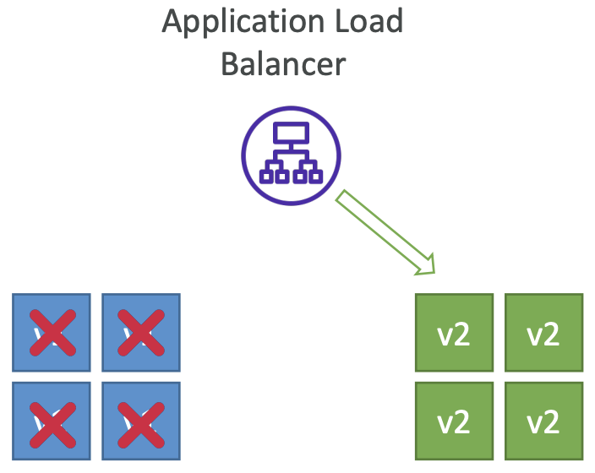
CodeDeploy – Blue/Green Deployments Instance Termination
BlueInstanceTerminationOption – specify whether to terminate the original (Blue) EC2 instances after a successfully Blue-Green deployment
Action Terminate - Specify Wait Time, default 1 hour, max 2 days
Action Keep Alive - Instances are kept running but deregistered from ELB and deployment group

Slide 33
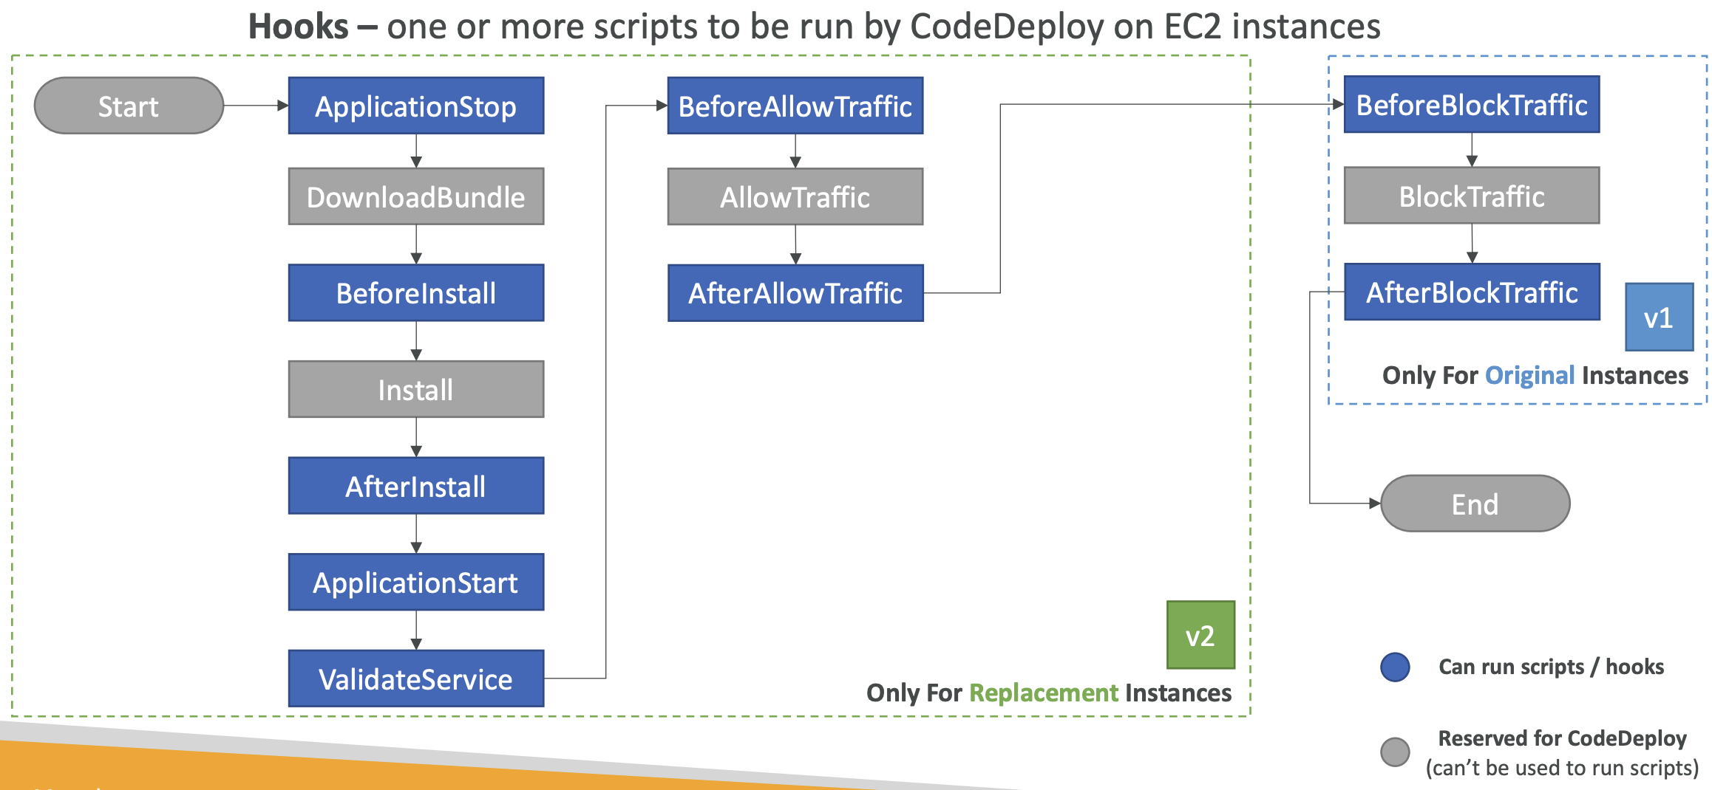
CodeDeploy – Blue/Green Deployment Hooks

Slide 34

CodeDeploy – Deployment Configuration
Specifies the number of instances that must remain available at any time during the deployment
Use Pre-defined Deployment Configurations
CodeDeployDefault.AllAtOnce – deploy to as many instances as possible at once
CodeDeployDefault.HalfAtATime – deploy to up to half of the instances at a time
CodeDeployDefault.OneAtATime – deploy to only one instance at a time
Can create your own custom Deployment Configurations

Slide 35
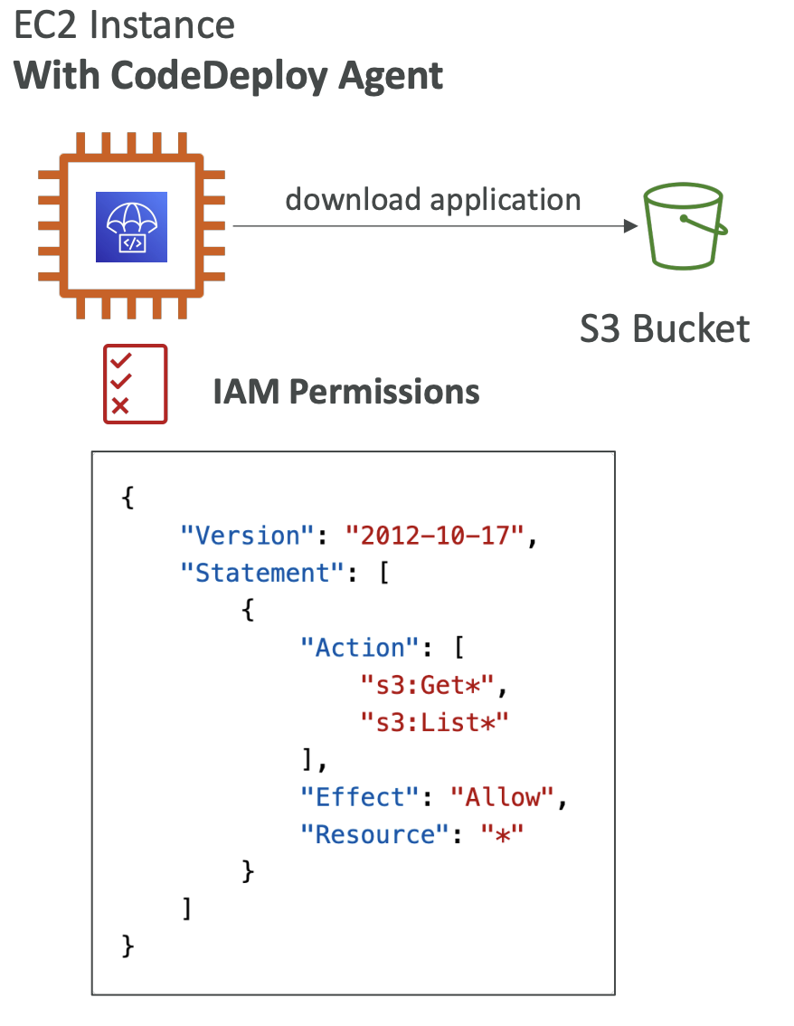
CodeDeploy - Agent
The CodeDeploy Agent must be running on the EC2 instances as a prerequisites
It can be installed and updated automatically if you’re using Systems Manager
The EC2 Instances must have sufficient permissions to access Amazon S3 to get deployment bundles

Slide 36
AWS CodeGuru

Slide 37
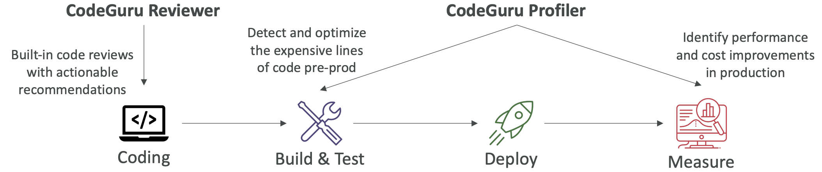
Amazon CodeGuru
An ML-powered service for automated code reviews and application performance recommendations
Provides two functionalities
CodeGuru Reviewer: automated code reviews for static code analysis (development)
CodeGuru Profiler: visibility/recommendations about application performance during runtime (production)

Slide 38
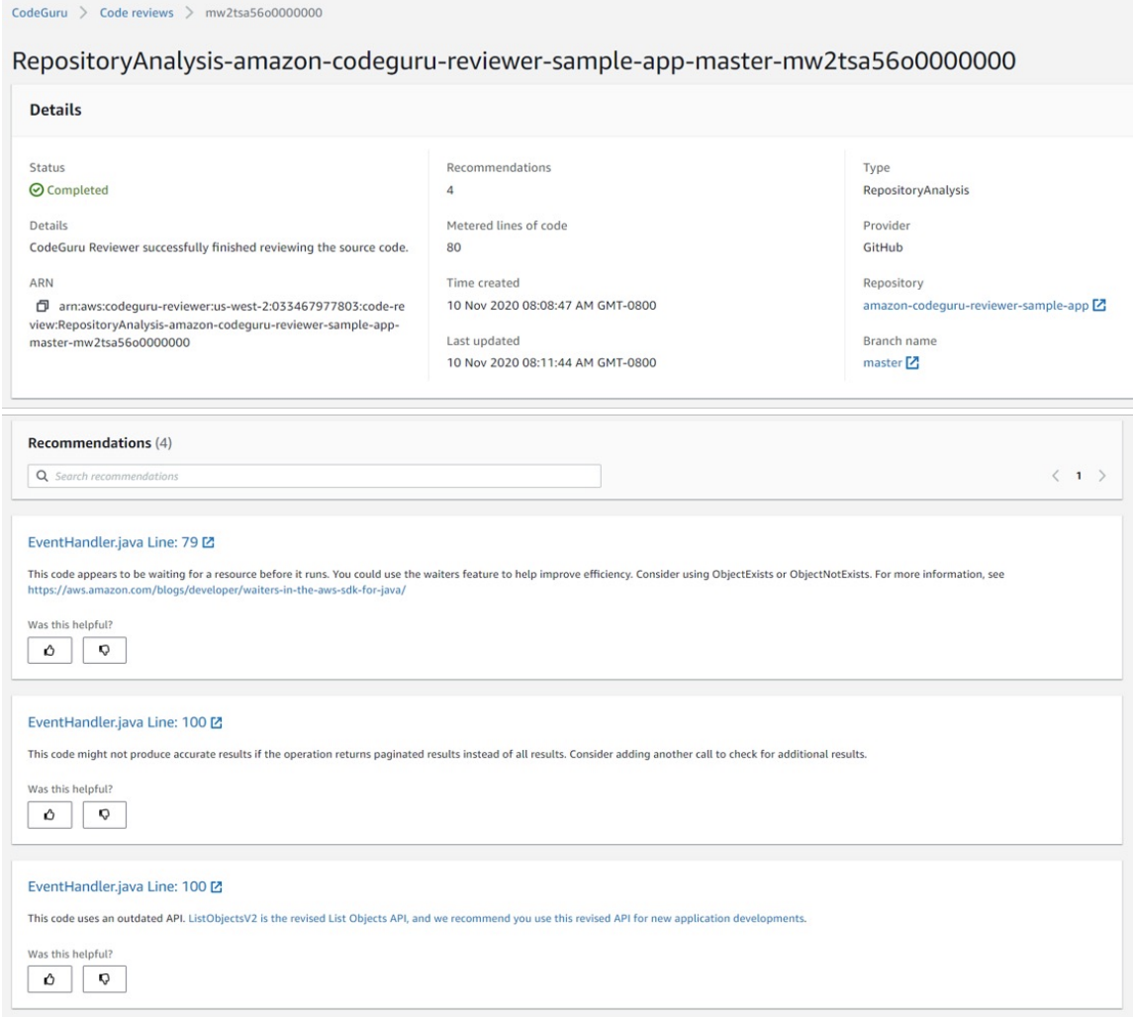
Amazon CodeGuru Reviewer
Identify critical issues, security vulnerabilities, and hard-to-find bugs
Example: common coding best practices, resource leaks, security detection, input validation
Uses Machine Learning and automated reasoning
Hard-learned lessons across millions of code reviews on 1000s of open-source and Amazon repositories
Supports Java and Python
Integrates with GitHub, Bitbucket, and AWS CodeCommit

Slide 39
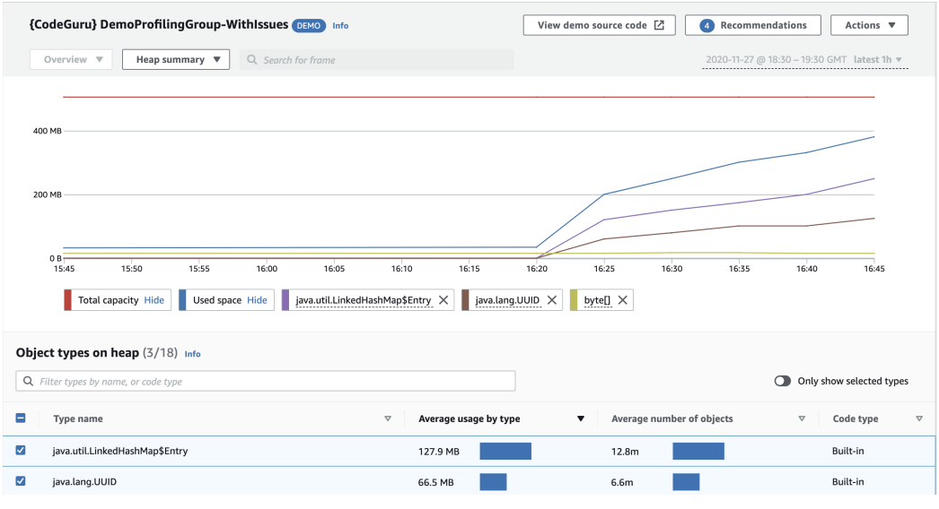
Amazon CodeGuru Profiler
Helps understand the runtime behavior of your application
Example: identify if your application is consuming excessive CPU capacity on a logging routine
Features:
Identify and remove code inefficiencies
Improve application performance (e.g., reduce CPU utilization)
Decrease compute costs
Provides heap summary (identify which objects using up memory)
Anomaly Detection
Support applications running on AWS or on- premise
Minimal overhead on application

Slide 40

Labs

Slide 41
Lab Requirements
AWS Console Access with ability to create IAM role, CodePipeline, CodeBuild, Beanstalk
Lab Sheet and Lab Material. Download the Lab.zip from https://github.com/paragsanyashiv/CICD
For Role Access, AdministratorAccess can be provided to a Group and then the Users can be assigned to the group. The Lab Document contains Opted permission details in the Pre-requisite section

Slide 42
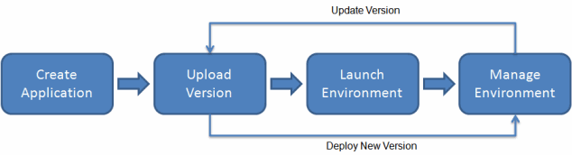
ELASTIC BEANSTALK
Quickly deploy and manage applications in the AWS Cloud without having to learn about the infrastructure that runs those applications.
Elastic Beanstalk supports applications developed in Go, Java, .NET, Node.js, PHP, Python, and Ruby. Elastic Beanstalk also supports Docker platforms.
To use Elastic Beanstalk, you create an application, upload an application version in the form of an application source bundle (for example, a Java .war file) to Elastic Beanstalk, and then provide some information about the application.
Elastic Beanstalk automatically launches an environment and creates and configures the AWS resources needed to run your code. After your environment is launched, you can then manage your environment and deploy new application versions. The following diagram illustrates the workflow of Elastic Beanstalk.

Slide 43
QUESTIONS?

Slide 44
THANK YOU

